Slide 1

COMPUTER NETWORKS (BCSC 0008)
Copyright content, use only with the written permission of presenter mentioned
DIGITAL SIGNALS
DIGITAL TO DIGITAL CONVERSION (LINE CODING)
Chapter 4 (FOUROZAN 4th Edition)

Slide 2
Text and Reference Books
Text Books:
Fourouzan B. A. (2004), “Data Communication and Networking”, 4th Edition, McGraw-Hill.
References:
Kurose, J. F. and Ross K. W. (2005), “Computer Networking: A Top-Down Approach Featuring the Internet”, 3rd Edition, Addison-Wesley.
A. S. Tanenbaum (2006), “Computer Networks”, 2nd Edition, Prentice Hall India.

Slide 3
Previous discussed topics:
OSI Model
TCP/IP Model
Addressing
Data & Signals
Transmission Media
Now we will discuss:
Data element vs. Signal element
Baud Rate
Line Coding Schemes ( Unipolar & Polar )

Slide 4
4-1 DIGITAL-TO-DIGITAL CONVERSION
In this section, we see how we can represent digital data by using digital signals. The conversion involves three techniques: line coding, block coding, and scrambling. Line coding is always needed; block coding and scrambling may or may not be needed.
Topics discussed in this section:
Line Coding
Line Coding Schemes

Slide 5
Line Coding
Converting a string of 1’s and 0’s (digital data) into a sequence of signals that denote the 1’s and 0’s.
For example a high voltage level (+V) could represent a “1” and a low voltage level (0 or -V) could represent a “0”.

Slide 6
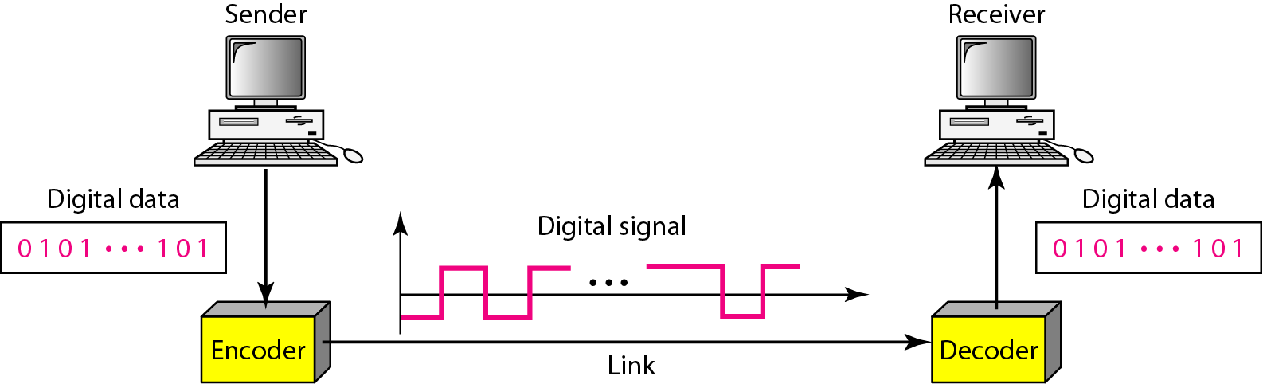
Figure 4.1 Line coding and decoding

Slide 7
Mapping Data symbols onto Signal levels
A data symbol (or element) can consist of a number of data bits:
1 , 0 or
11, 10, 01, ……
A data symbol can be coded into a single signal element or multiple signal elements
1 -> +V, 0 -> -V
1 -> +V and -V, 0 -> -V and +V
The ratio ‘r’ is the number of data elements carried by a signal element.

Slide 8
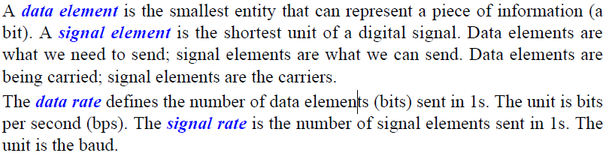
Relationship between data rate and signal rate
The data rate defines the number of bits sent per sec - bps. It is often referred to the bit rate. The signal rate is the number of signal elements sent in a second and is measured in bauds. It is also referred to as the modulation rate or baud rate.
Goal is to increase the data rate whilst reducing the baud rate.

Slide 9
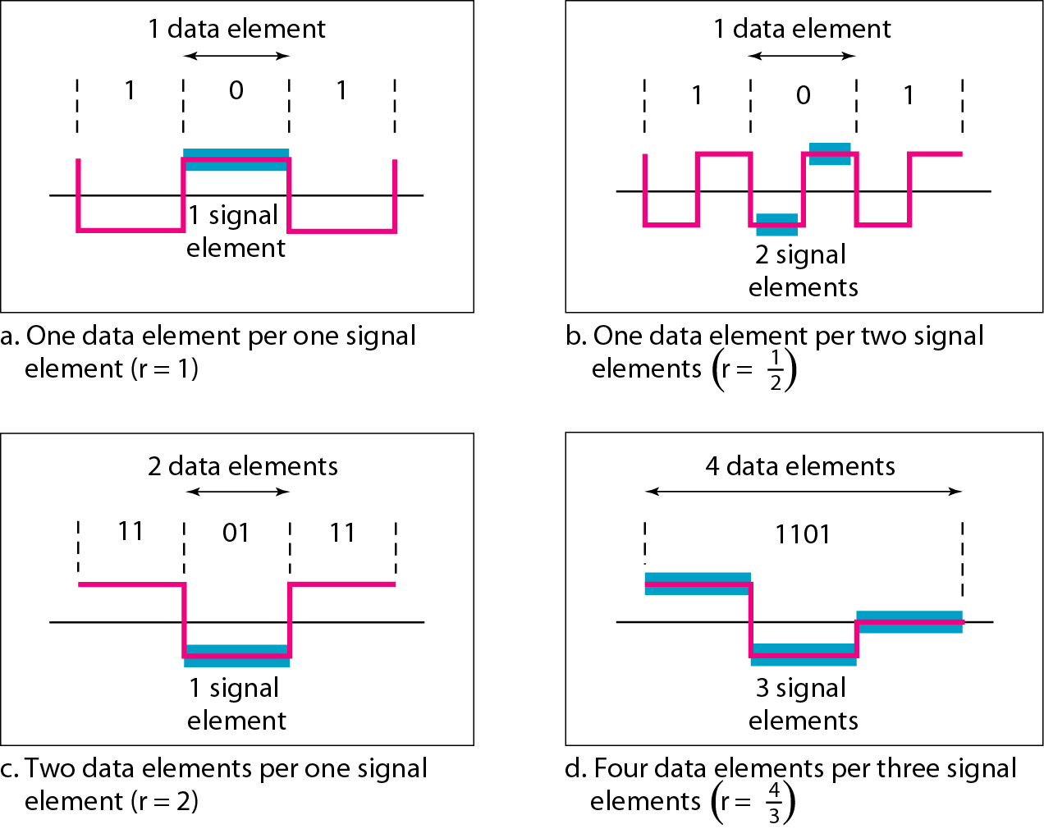
Figure 4.2 Signal element versus data element

Slide 10
Data rate and Baud rate
The baud or signal rate can be expressed as:
S = c x N x 1/r bauds
Where,
N is data rate
c is the case factor (worst, best & avg.)
r is the ratio between data element & signal element

Slide 11
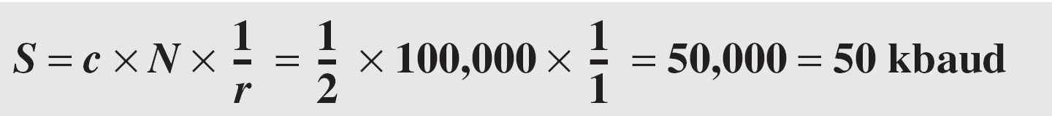
Example 1
A signal is carrying data in which one data element is encoded as one signal element ( r = 1). If the bit rate is 100 kbps, what is the average value of the baud rate if c is between 0 and 1?
Solution
We assume that the average value of c is 1/2 . The baud rate is then

Slide 12
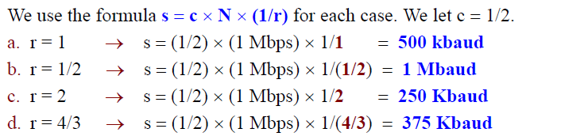
Calculate the value of signal rate for each of the cases if data rate is 1 Mbps and c= 1/2

Slide 13

Note
Although the actual bandwidth of a digital signal is infinite, the effective bandwidth is finite.

Slide 14
Considerations for choosing a good signal element referred to as line encoding
Baseline wandering - a receiver will evaluate the average power of the received signal (called the baseline) and use that to determine the value of the incoming data elements. If the incoming signal does not vary over a long period of time, the baseline will drift and thus cause errors in detection of incoming data elements. A good line encoding scheme will prevent long runs of fixed amplitude.
DC components - when the voltage level remains constant for long periods of time, there is an increase in the low frequencies of the signal. Most channels are bandpass and may not support the low frequencies. This will require the removal of the dc component of a transmitted signal.

Slide 15
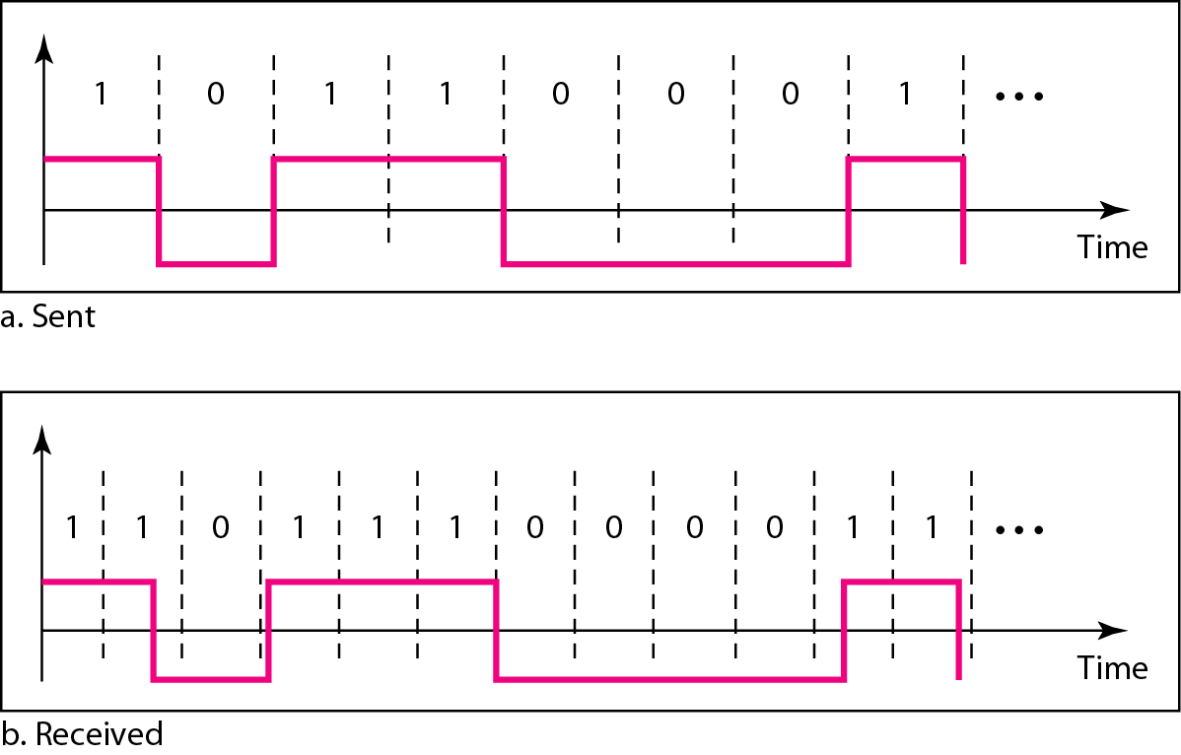
Line encoding C/Cs
Self synchronization - the clocks at the sender and the receiver must have the same bit interval. If the receiver clock is faster or slower it will misinterpret the incoming bit stream.
Effect of lack of synchronization

Slide 16
Example 2
In a digital transmission, the receiver clock is 0.1 percent faster than the sender clock. How many extra bits per second does the receiver receive if the data rate is 1 kbps? How many if the data rate is 1 Mbps?
Solution
At 1 kbps, the receiver receives 1001 bps instead of 1000 bps.
At 1 Mbps, the receiver receives 1,001,000 bps instead of 1,000,000 bps.

Slide 17
Line encoding C/Cs
Error detection - errors occur during transmission due to line impairments. Some codes are constructed such that when an error occurs it can be detected. For example: a particular signal transition is not part of the code. When it occurs, the receiver will know that a symbol error has occurred.
Noise and interference - there are line encoding techniques that make the transmitted signal “immune” to noise and interference. This means that the signal cannot be corrupted, it is stronger than error detection.
Complexity - the more robust and resilient the code, the more complex it is to implement and the price is often paid in baud rate or required bandwidth.

Slide 18
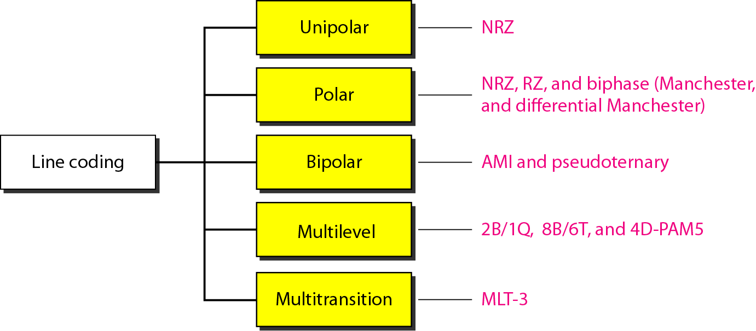
Figure 4.4 Line coding schemes
Not part of Syllabus

Slide 19
Unipolar Line Coding Scheme
All signal levels are on one side of the time axis - either above or below
NRZ - Non Return to Zero scheme is an example of this code. The signal level does not return to zero during a symbol transmission (during bit duration). The signal will change level at the edge of the time interval and not in between.
Scheme is prone to baseline wandering and DC components. It has no synchronization or any error detection. It is simple but costly in power consumption.

Slide 20
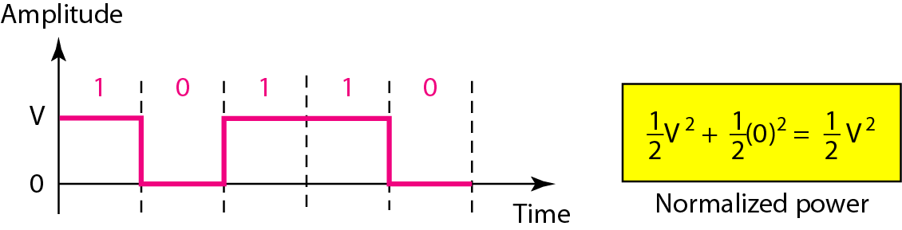
Figure 4.5 Unipolar NRZ scheme
Assumption: data element ‘1’ is on positive side of axis and data element ‘0’ is on the axis.
NOTE: data element ‘1’ is on negative side of axis and data element ‘0’ is on the axis can also be assumed

Slide 21
Polar – NRZ Line Coding Scheme
The voltages are on both sides of the time axis.
The signal level does not return to zero during a symbol transmission (during bit duration). The signal will change level at the edge of the time interval and not in between.
Polar NRZ scheme can be implemented with two voltages. E.g. +V for 1 and -V for 0 or vice versa
There are two versions:
NZR - Level (NRZ-L) - positive voltage for one symbol and negative for the other
NRZ - Inversion (NRZ-I) - the change or lack of change in polarity determines the value of a symbol. E.g. a “1” symbol inverts the polarity a “0” does not.

Slide 22
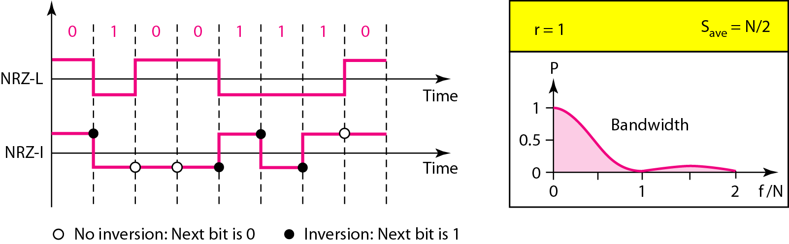
Figure 4.6 Polar NRZ-L and NRZ-I schemes
Assumption: +V for 0 and -V for 1

Slide 23
Note
In NRZ-L the level of the voltage determines the value of the bit. In NRZ-I the inversion or the lack of inversion determines the value of the bit.

Slide 24
Polar –RZ Line Coding Scheme
The Return to Zero (RZ) scheme uses three voltage values. +, 0, -.
Each symbol has a transition in the middle. Either from high to zero or from low to zero.
The signal level will return to zero during a symbol transmission (during bit duration). The signal will not change level at the edge of the time interval and will in between of the signal element or bit duration.
This scheme has more signal transitions (two per symbol) and therefore requires a wider bandwidth.

Slide 25
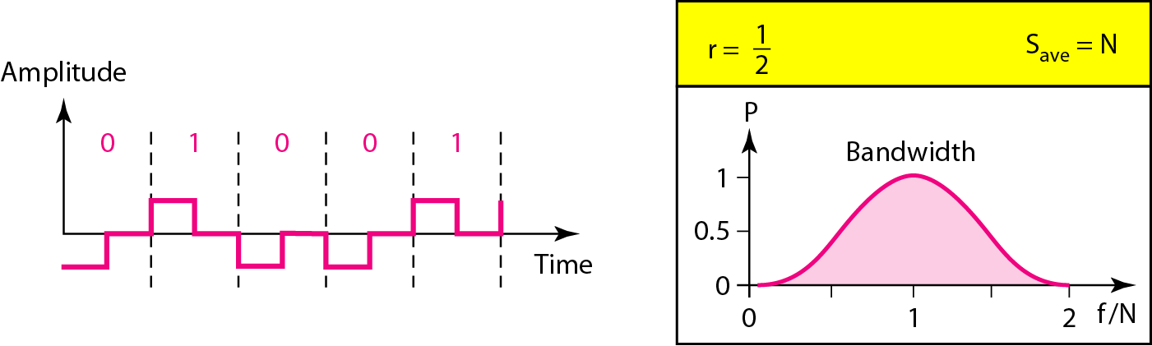
Figure 4.7 Polar RZ scheme
Assumption: +V for 1 and -V for 0
One Bit Duration, Signal is returning to zero axis during the bit i.e., at the
middle of the signal element transmission and not at the edge of the interval

Slide 26
Polar Biphase: Manchester and Differential Manchester
Manchester coding consists of combining the NRZ-L and RZ schemes.
Every symbol has a level transition in the middle: from high to low or low to high. Uses only two voltage levels.
Differential Manchester coding consists of combining the NRZ-I and RZ schemes.
Every symbol has a level transition in the middle. But the level at the beginning of the symbol is determined by the symbol value. One symbol causes a level change the other does not.

Slide 27
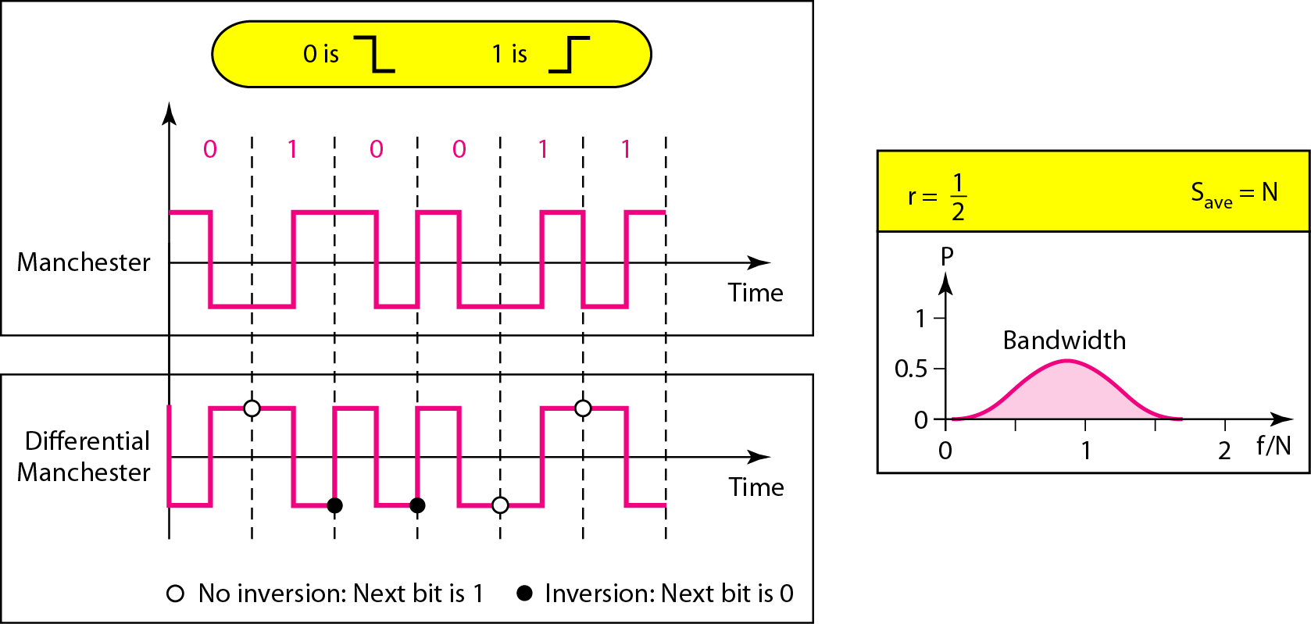
Figure 4.8 Polar biphase: Manchester and differential Manchester schemes

Slide 28
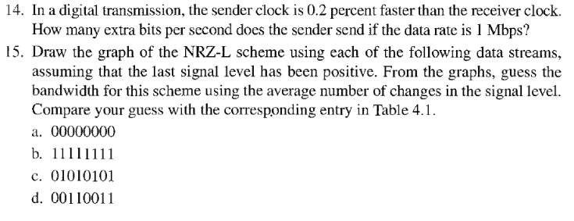

Question

Slide 29
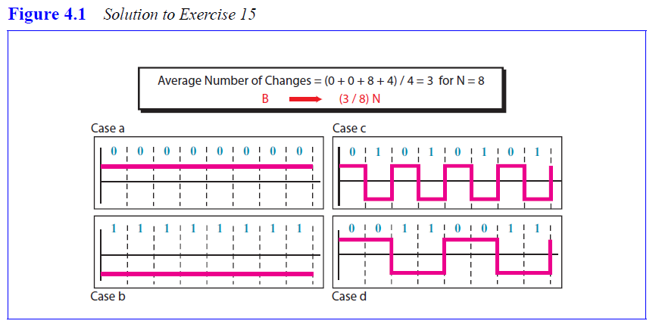
Solution

Slide 30
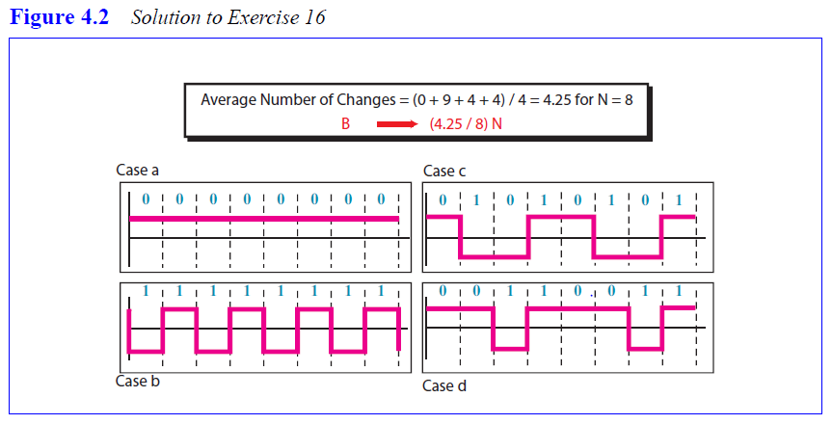
Solution

Slide 31
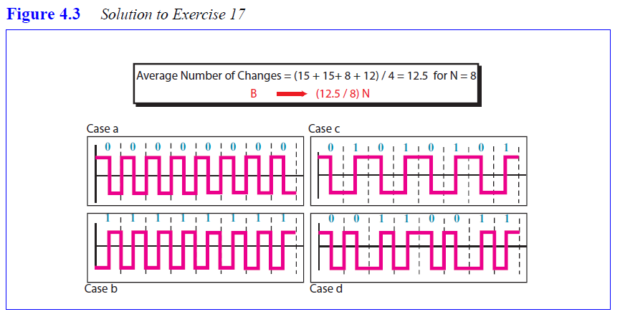
Solution

Slide 32
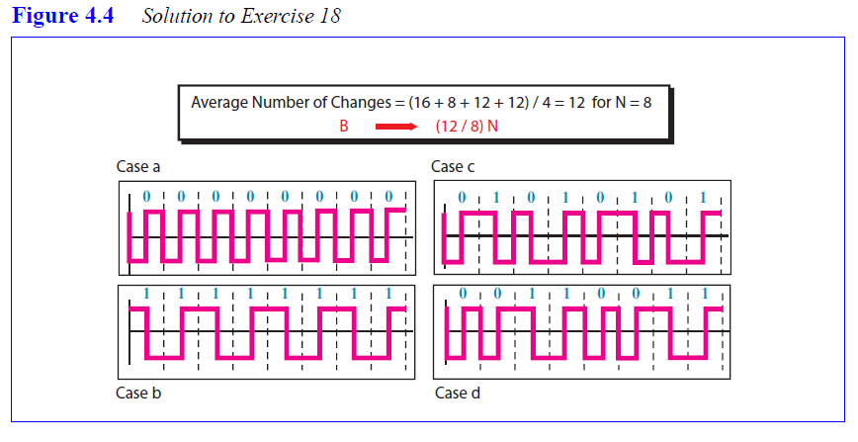
Solution

